Slide 1
Chapter 27
Introduction to Information Retrieval and Web Search

Slide 2
Chapter 27 Outline
Information Retrieval (IR) Concepts
Retrieval Models
Types of Queries in IR Systems
Text Preprocessing
Inverted Indexing

Slide 3
Chapter 27 Outline (cont’d.)
Evaluation Measures of Search Relevance
Web Search and Analysis
Trends in Information Retrieval

Slide 4
Information Retrieval (IR) Concepts
Information retrieval
  Process of retrieving documents from a collection in response to a query by a user
Introduction to information retrieval
  What is the distinction between structured and unstructured data?
  Information retrieval defined
    “Discipline that deals with the structure, analysis, organization, storage, searching, and retrieval of information”

Slide 5
Information Retrieval (IR) Concepts (cont’d.)
User’s information need expressed as a free-form search request
  Keyword search query
  Query
IR systems characterized by:
  Types of users
  Types of data
  Types of information needed
  Levels of scale

Slide 6
Information Retrieval (IR) Concepts (cont’d.)
High noise-to-signal ratio
Enterprise search systems
  IR solutions for searching different entities in an enterprise’s intranet
Desktop search engines
  Retrieve files, folders, and different kinds of entities stored on the computer

Slide 7
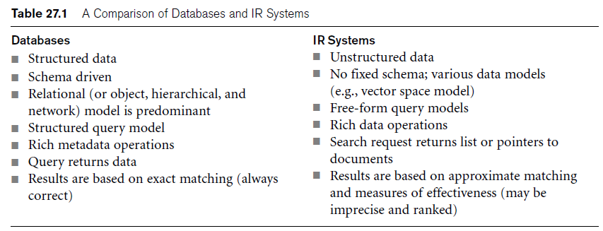
Databases and IR Systems: A Comparison

Slide 8
Brief History of IR
Inverted file organization
  Based on keywords and their weights
  SMART system in 1960s
Text Retrieval Conference (TREC)
Search engine
  Application of information retrieval to large-scale document collections
  Crawler
    Responsible for discovering, analyzing, and indexing new documents

Slide 9
Modes of Interaction in IR Systems
Query
  Set of terms
    Used by searcher to specify information need
Main modes of interaction with IR systems:
  Retrieval
    Extraction of information from a repository of documents through an IR query
  Browsing
    User visiting or navigating through similar or related documents

Slide 10
Modes of Interaction in IR Systems (cont’d.)
Hyperlinks
  Used to interconnect Web pages
  Mainly used for browsing
Anchor texts
  Text phrases within documents used to label hyperlinks
  Very relevant to browsing

Slide 11
Modes of Interaction in IR Systems (cont’d.)
Web search
  Combines browsing and retrieval
Rank of a Webpage
  Measure of relevance to query that generated result set

Slide 12
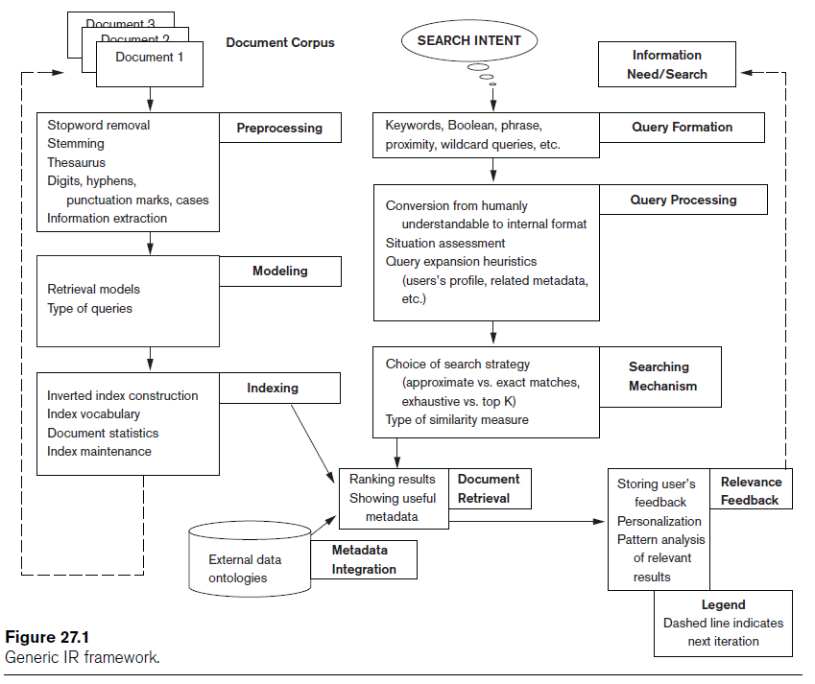
Generic IR Pipeline

Slide 13
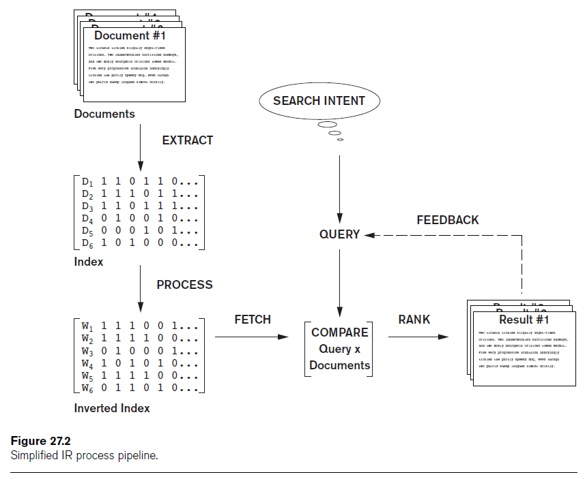
Generic IR Pipeline (cont’d.)

Slide 14
Retrieval Models
Three main statistical models
  Boolean
  Vector space
  Probabilistic
Semantic model

Slide 15
Boolean Model
Documents represented as a set of terms
Form queries using standard Boolean logic set-theoretic operators
  AND, OR and NOT
Retrieval and relevance
  Binary concepts
Lacks sophisticated ranking algorithms

Slide 16
Vector Space Model
Documents
  Represented as features and weights in an n-dimensional vector space
Query
  Specified as a terms vector
  Compared to the document vectors for similarity/relevance assessment

Slide 17
Vector Space Model (cont’d.)
Different similarity functions can be used
  Cosine of the angle between the query and document vector commonly used
TF-IDF
  Statistical weight measure
  Used to evaluate the importance of a document word in a collection of documents
Rocchio algorithm
  Well-known relevance feedback algorithm

Slide 18
Probabilistic Model
Probability ranking principle
  Decide whether the document belongs to the relevant set or the nonrelevant set for a query
Conditional probabilities calculated using Bayes’ Rule
BM25 (Best Match 25)
  Popular probabilistic ranking algorithm
Okapi system

Slide 19
Semantic Model
Include different levels of analysis
  Morphological
  Syntactic
  Semantic
Knowledge-based IR systems
  Based on semantic models
  Cyc knowledge base
  WordNet

Slide 20
Types of Queries in IR Systems
Keywords
  Consist of words, phrases, and other characterizations of documents
  Used by IR system to build inverted index
Queries compared to set of index keywords
Most IR systems
  Allow use of Boolean and other operators to build a complex query

Slide 21
Keyword Queries
Simplest and most commonly used forms of IR queries
Keywords implicitly connected by a logical AND operator
Remove stopwords
  Most commonly occurring words
    a, the, of
IR systems do not pay attention to the ordering of these words in the query

Slide 22
Boolean Queries
AND: both terms must be found
OR: either term found
NOT: record containing keyword omitted
( ): used for nesting
+: equivalent to and
– Boolean operators: equivalent to AND NOT
Document retrieved if query logically true as exact match in document

Slide 23
Phrase Queries
Phrases encoded in inverted index or implemented differently
Phrase generally enclosed within double quotes
More restricted and specific version of proximity searching

Slide 24
Proximity Queries
Accounts for how close within a record multiple terms should be to each other
Common option requires terms to be in the exact order
Various operator names
  NEAR, ADJ(adjacent), or AFTER
Computationally expensive

Slide 25
Wildcard Queries
Support regular expressions and pattern matching-based searching
  ‘Data*’ would retrieve data, database, datapoint, dataset
Involves preprocessing overhead
Not considered worth the cost by many Web search engines today
Retrieval models do not directly provide support for this query type

Slide 26
Natural Language Queries
Few natural language search engines
Active area of research
Easier to answer questions
  Definition and factoid questions

Slide 27
Text Preprocessing
Commonly used text preprocessing techniques
Part of text processing task

Slide 28
Stopword Removal
Stopwords
  Very commonly used words in a language
  Expected to occur in 80 percent or more of the documents
  the, of, to, a, and, in, said, for, that, was, on, he, is, with, at, by, and it
Removal must be performed before indexing
Queries can be preprocessed for stopword removal

Slide 29
Stemming
Stem
  Word obtained after trimming the suffix and prefix of an original word
Reduces different forms of the word formed by inflection
Most famous stemming algorithm:
  Martin Porter’s stemming algorithm

Slide 30
Utilizing a Thesaurus
Thesaurus
  Precompiled list of important concepts and the main word that describes each
  Synonym converted to its matching concept during preprocessing
  Examples:
    UMLS
      Large biomedical thesaurus of concepts/meta concepts/relationships
    WordNet
      Manually constructed thesaurus that groups words into strict synonym sets

Slide 31
Other Preprocessing Steps: Digits, Hyphens, Punctuation Marks, Cases
Digits, dates, phone numbers, e-mail addresses, and URLs may or may not be removed during preprocessing
Hyphens and punctuation marks
  May be handled in different ways
Most information retrieval systems perform case-insensitive search
Text preprocessing steps language specific

Slide 32
Information Extraction
Generic term
Extracting structured content from text
Examples of IE tasks
Mostly used to identify contextually relevant features that involve text analysis, matching, and categorization

Slide 33
Inverted Indexing
Vocabulary
  Set of distinct query terms in the document set
Inverted index
  Data structure that attaches distinct terms with a list of all documents that contains term
Steps involved in inverted index construction

Slide 34
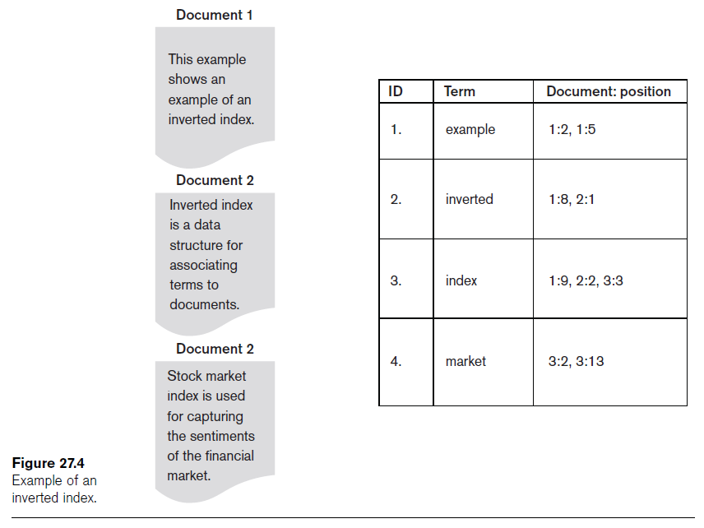

Slide 35
Evaluation Measures of Search Relevance
Topical relevance
  Measures extent to which topic of a result matches topic of query
User relevance
  Describes “goodness” of a retrieved result with regard to user’s information need
Web information retrieval
  Must evaluate document ranking order

Slide 36
Recall and Precision
Recall
  Number of relevant documents retrieved by a search / Total number of existing relevant documents
Precision
  Number of relevant documents retrieved by a search / Total number of documents retrieved by that search

Slide 37
Recall and Precision (cont’d.)
Average precision
  Useful for computing a single precision value to compare different retrieval algorithms
Recall/precision curve
  Usually has a negative slope indicating inverse relationship between precision and recall
F-score
  Single measure that combines precision and recall to compare different result sets

Slide 38
Web Search and Analysis
Vertical search engines
  Topic-specific search engines
Metasearch engines
  Query different search engines simultaneously
Digital libraries
  Collections of electronic resources and services

Slide 39
Web Analysis and Its Relationship to IR
Goals of Web analysis:
  Improve and personalize search results relevance
  Identify trends
Classify Web analysis:
  Web content analysis
  Web structure analysis
  Web usage analysis

Slide 40
Searching the Web
Hyperlink components
  Destination page
  Anchor text
Hub
  Web page or a Website that links to a collection of prominent sites (authorities) on a common topic

Slide 41
Analyzing the Link Structure of Web Pages
The PageRank ranking algorithm
  Used by Google
  Highly linked pages are more important (have greater authority) than pages with fewer links
  Measure of query-independent importance of a page/node
HITS Ranking Algorithm
  Contains two main steps: a sampling component and a weight-propagation component

Slide 42
Web Content Analysis
Structured data extraction
  Several approaches: writing a wrapper, manual extraction, wrapper induction, wrapper generation
Web information integration
  Web query interface integration and schema matching
Ontology-based information integration
  Single, multiple, and hybrid

Slide 43
Web Content Analysis (cont’d.)
Building concept hierarchies
  Documents in a search result are organized into groups in a hierarchical fashion
Segmenting Web pages and detecting noise
  Eliminate superfluous information such as ads and navigation

Slide 44
Approaches to Web Content Analysis
Agent-based approach categories
  Intelligent Web agents
  Information filtering/categorization
  Personalized Web agents
Database-based approach
  Infer the structure of the Website or to transform a Web site to organize it as a database

Slide 45
Web Usage Analysis
Typically consists of three main phases:
  Preprocessing, pattern discovery, and pattern analysis
Pattern discovery techniques:
  Statistical analysis
  Association rules
  Clustering of users
    Establish groups of users exhibiting similar browsing patterns

Slide 46
Web Usage Analysis (cont’d.)
  Clustering of pages
    Pages with similar contents are grouped together
  Sequential patterns
  Dependency modeling
  Pattern modeling

Slide 47
Practical Applications of Web Analysis
Web analytics
  Understand and optimize the performance of Web usage
Web spamming
  Deliberate activity to promote a page by manipulating results returned by search engines
Web security
Alternate uses for Web crawlers

Slide 48
Trends in Information Retrieval
Faceted search
  Allows users to explore by filtering available information
  Facet
    Defines properties or characteristics of a class of objects
Social search
  New phenomenon facilitated by recent Web technologies: collaborative social search, guided participation

Slide 49
Trends in Information Retrieval (cont’d.)
Conversational search (CS)
  Interactive and collaborative information finding interaction
  Aided by intelligent agents

Slide 50
Summary
IR introduction
  Basic terminology, query and browsing modes, semantics, retrieval modes
Web search analysis
  Content, structure, usage
  Algorithms
  Current trends

